Slide 1
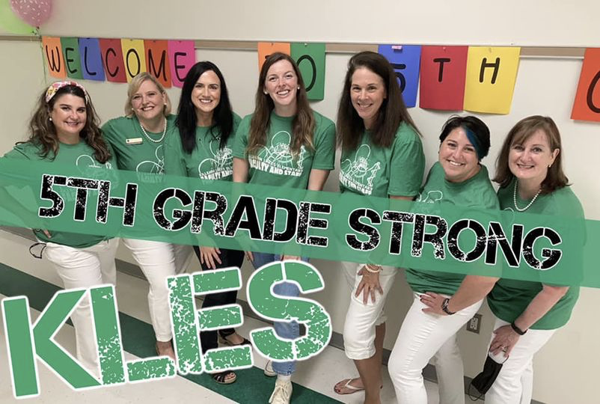
Welcome to Open House 2021-2022

Slide 2
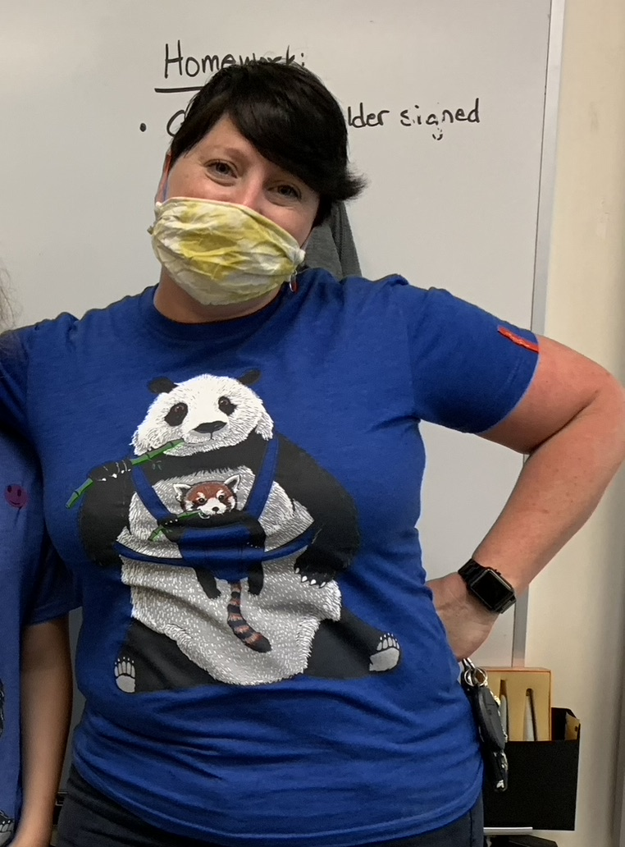
Mrs. Jimenez' Background
I have dual Bachelor degrees in Elementary Education and Exceptional Student Education from the Flagler College.
I am endorsements in Reading and ESOL.
I have been teaching for seven (7) years in the public school system.
This is my second (2nd) year at Killearn Lakes as a Fifth-Grade teacher.
I am a local from Tallahassee, graduating from Lincoln High School.
I love to play board games & volleyball, do puzzles, read,& snuggle my dogs.
I am currently taking a pottery class & DIY remodeling my master bathroom.
I teach because I enjoy learning and hope to instill a passion for learning in others.

Slide 3
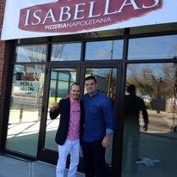
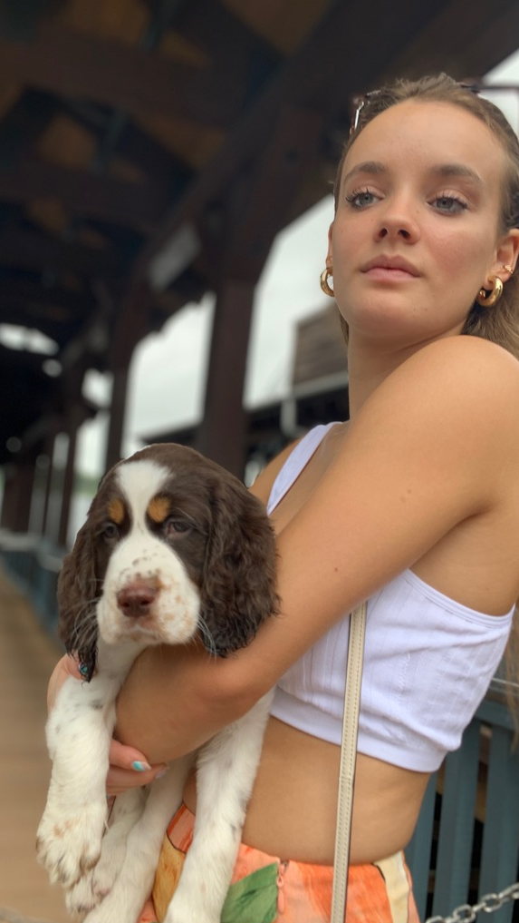
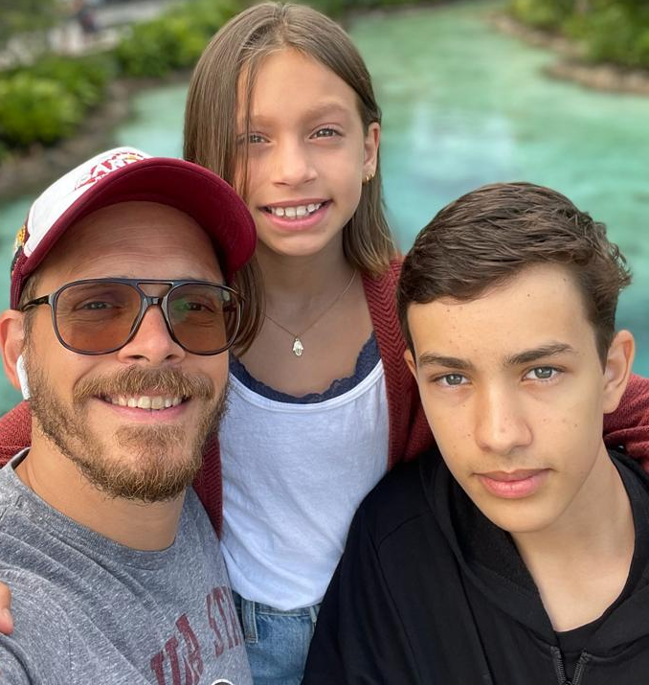
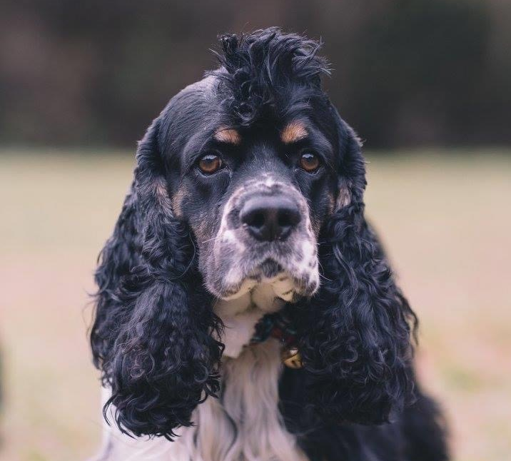
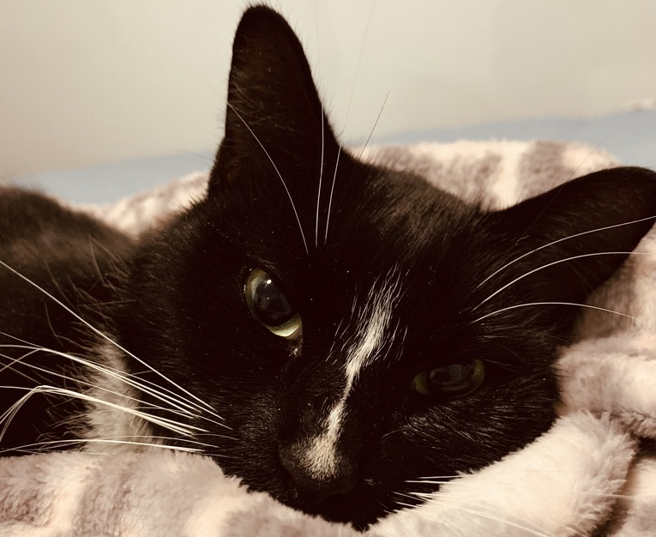
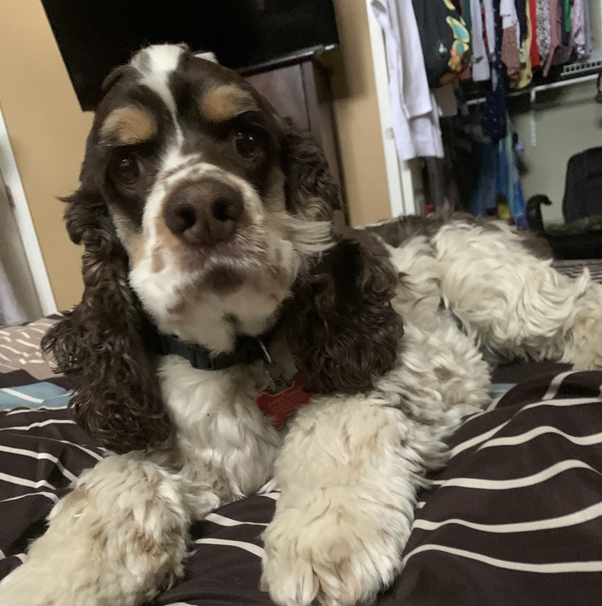
Jimenez Family

Slide 4
Ms. Jackson’s Background
Dual Bachelors in Elementary Education and Exceptional Student Education from the University of West Florida.
Endorsements in Reading and ESOL.
This is my 4th year teaching and a happy third year as a Fifth-Grade teacher at Killearn Lakes.
I spent my first-year teaching English and Mathematics in Thailand to 2nd, 3rd, & 6th grade!
I am the middle child of three and enjoy taking my Dachshund and Great Dane, Lola and Calliope, for runs on the trails!
In my spare time, I love to do any and all activities outdoors. Hiking, walking, kayaking, etc! I am currently training for my FIRST half marathon in October. Yay!

Slide 5
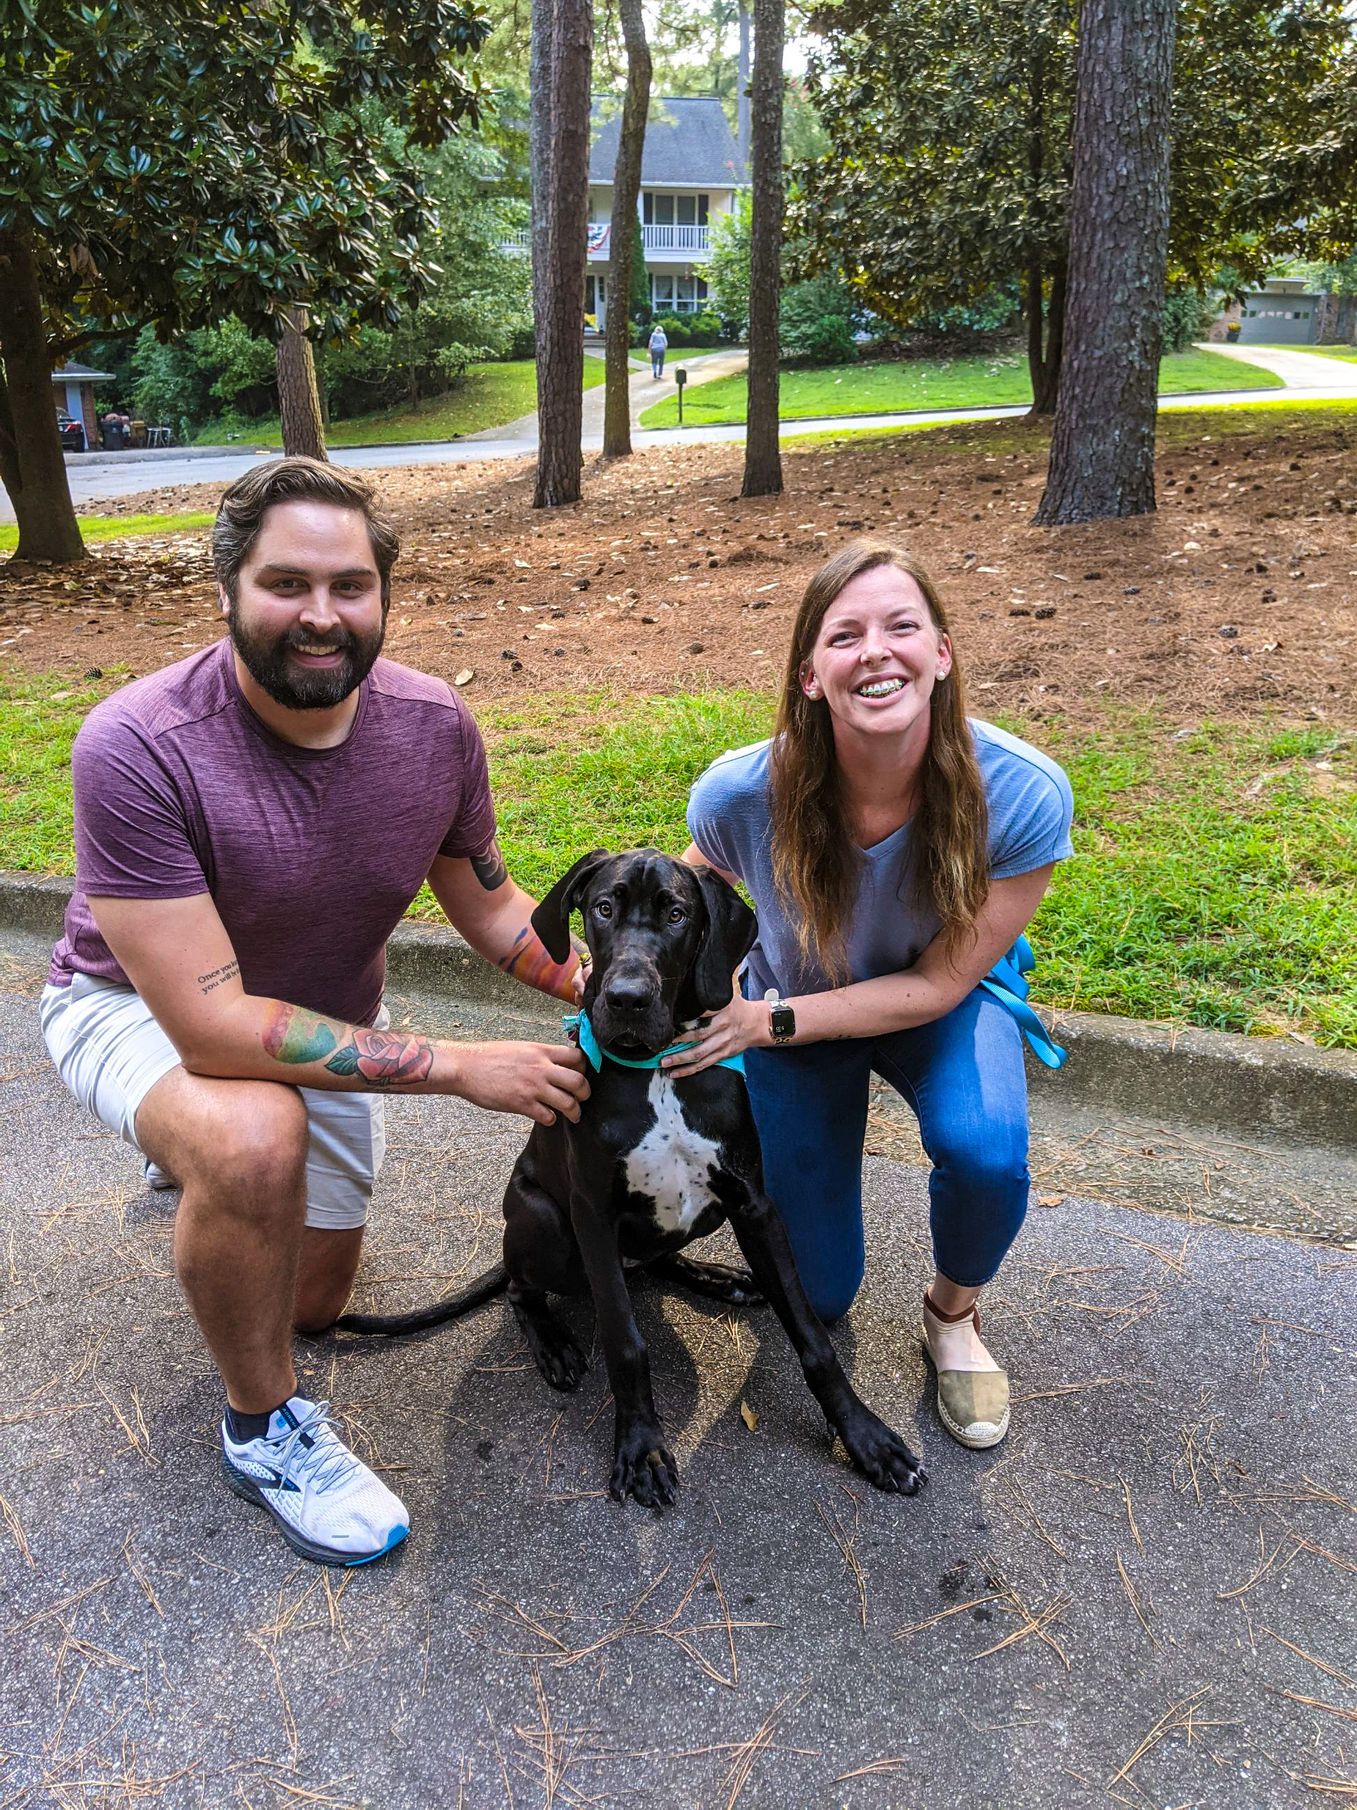
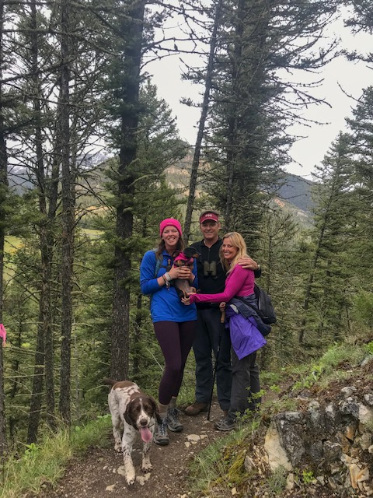
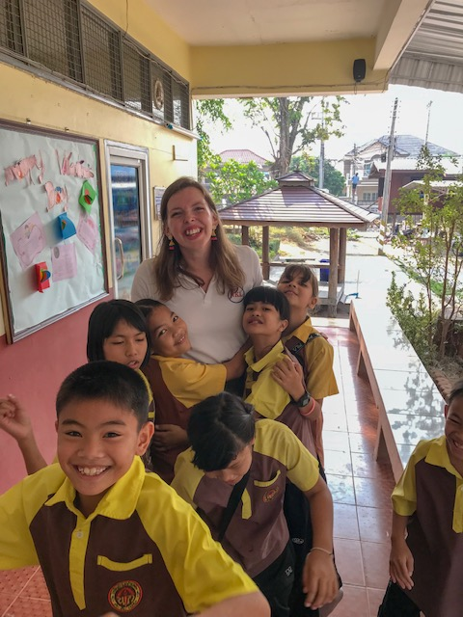
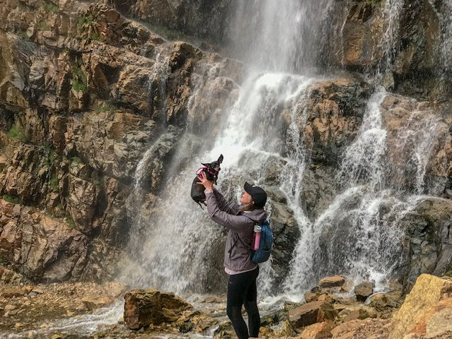
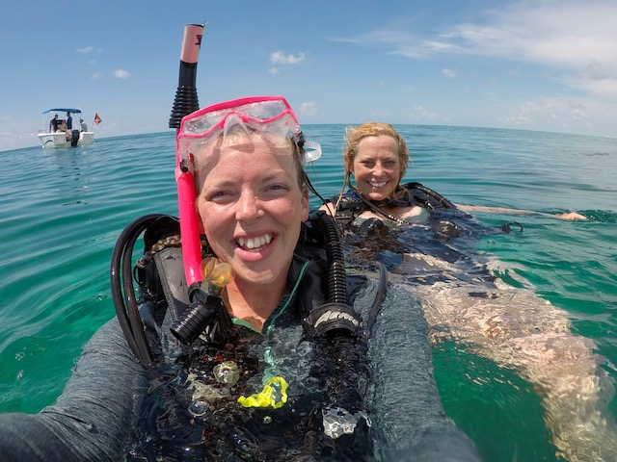
Notes:
5

Slide 6
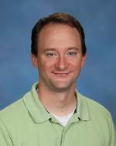
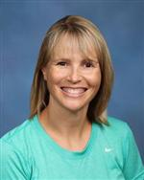
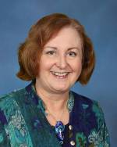
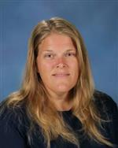
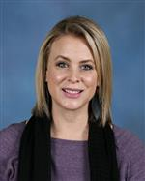
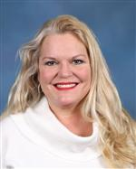
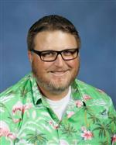
SPECIAL AREA

Slide 7
Grading Policy
Math/ELA Science/SS
50% Assessments 50% Assessments
20% Quizzes 20% Quizzes
25% Classwork 20% Projects/Investigations
5% Homework 10% Classwork
= 100% Hard Work

Slide 8
Folders:
Behavior Log
Reading folder is Red
Social Studies folder is Blue
Science is Green
Math folder is Yellow
Behavior Log:
Daily folder is PURPLE
Contains the daily schedule, WS/C behavior sheet, AR goal sheet, graded work, notes, and newsletters.
Please Sign it Each Week!

Slide 9
Citizenship & Work Study Habits
The behavior and work study grades from the purple folder directly coordinate with your child’s report card. No Surprises on Report Cards!
E = 3 or less checks C/ WS columns
S= 4-10 checks in the C/WS columns
N= 11+ checks in the C/WS columns
*Referrals to the office lower Citizenship grades.
**Not reaching an AR goal lowers a Work Study grade.

Slide 10
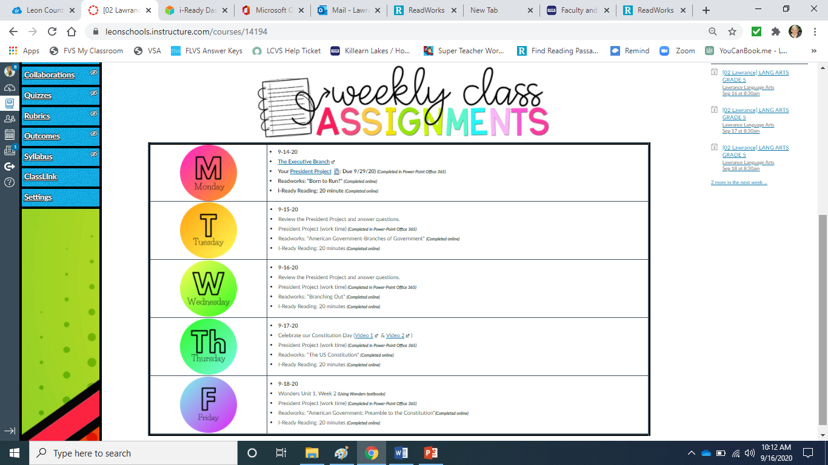
Reading and Social Studies

Slide 11
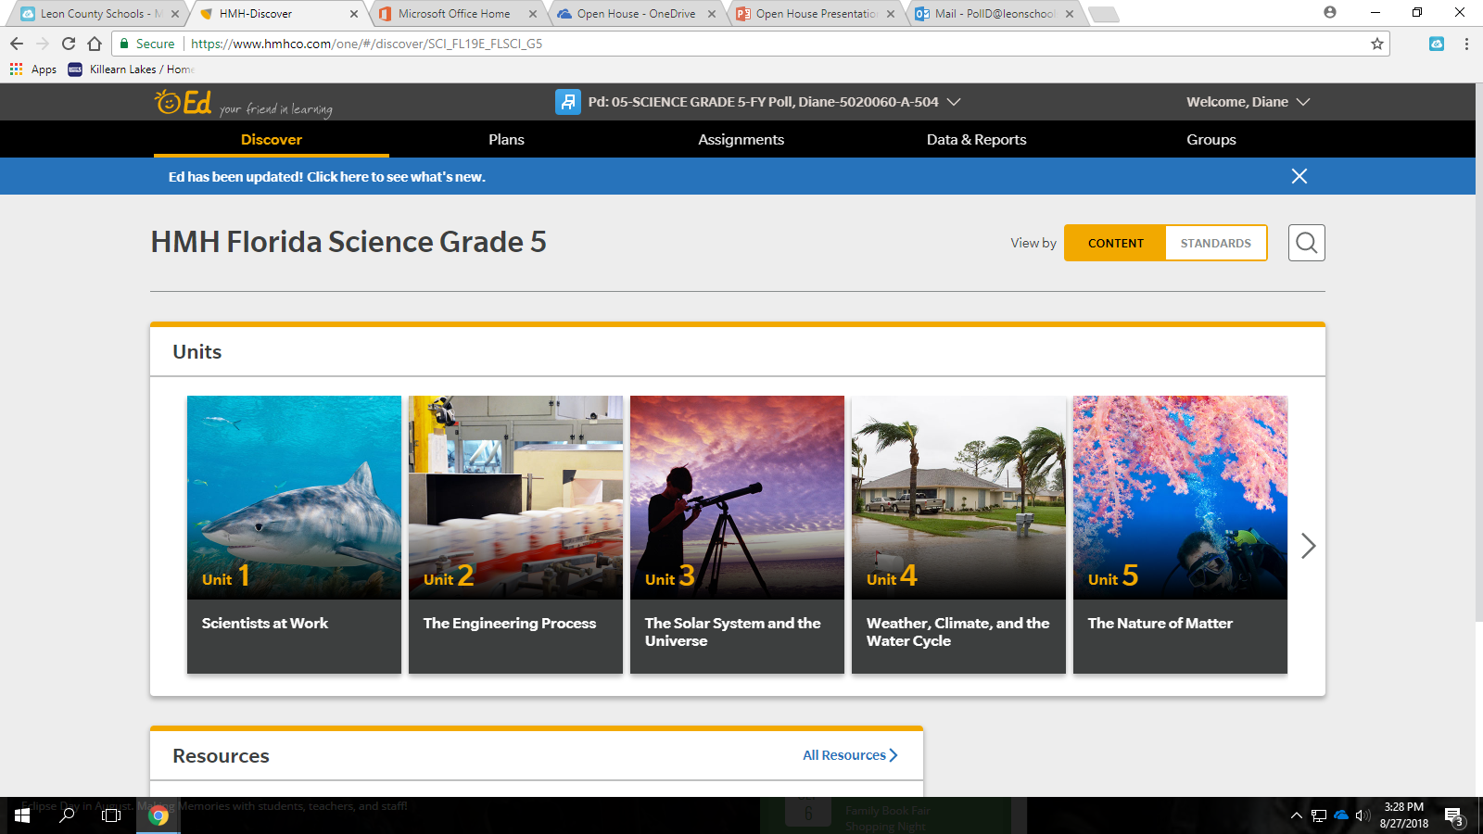
5th Grade Science
Science textbook Fusion covers…
Energy, Forces and Motion
Properties of Matter
The Structure of Living Things
The Nature of Science
Earth and Space
EdLearning online platform

Slide 12
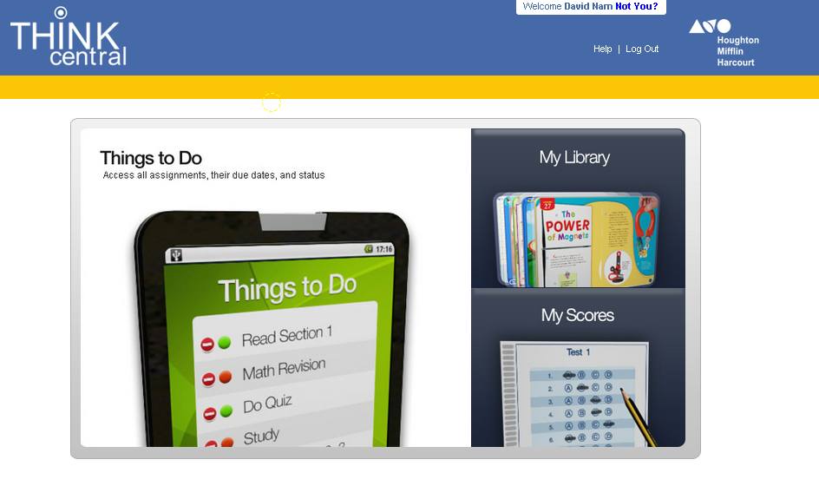
5th Grade Math
Math Series: Go Math (Think Central)
I-Ready
Freckle Math
Reflex Math
Students MUST know their facts:
Addition Practice
Subtraction Practice
Multiplication Practice
Division Practice
Trashketball Review Games

Slide 13
SEL Social Emotional Learning with Sandford Harmony
Progress Monitoring

Slide 14
Growth
KLES School Improvement Goals 2021-22
Reading Goal:
Increase learning gains of the lowest 25% in ELA by at least 5% as demonstrated on the FSA ELA Assessment.
Math Goal:
Increase learning gains of the lowest 25% in Math by at least 5% as demonstrated on the FSA Math Assessment.
Science Goal:
The percentage of 5th grade students performing at level 3 or above will increase at least 3% as demonstrated on the FCAT Science Assessment.
Parents and families, if you have any questions or input, please feel free to email Mr. McGrotha at mcgrothah@leonschools.net.

Slide 16
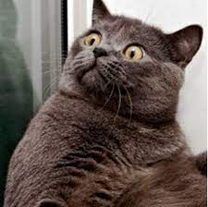
Technology
We have the following:
An interactive board
Audio Enhancement (speakers in the ceiling)
A document camera
One-to One Laptops

Slide 17
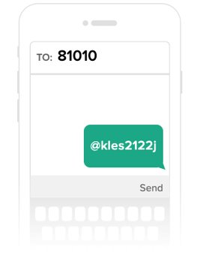
Communication
Mrs. Jackson will be handling all email communications.
Jacksonh2@leonschools.net
Mrs. J will be handling Remind/Text communications.
Sign-up for Remind notifications by texting ...
@kles2122j to the number 81010
Transportation changes should go through the front office no later than 2:00 P.M.
Please allow 24 to 48 hrs. for replies depending on the question and situation.

Slide 18
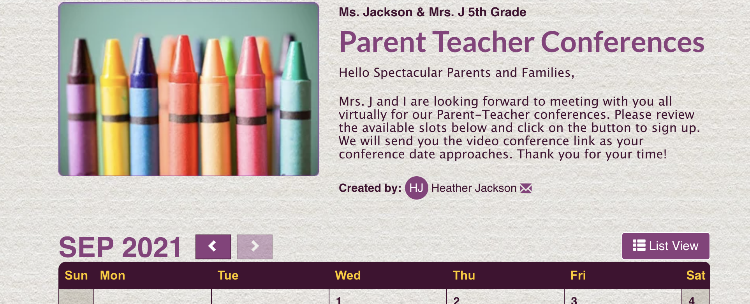
Conferences
We will use Signup Genius to set our times and Zoom for the virtual conferences. Conference information will be emailed following this Open House presentation.

Slide 19
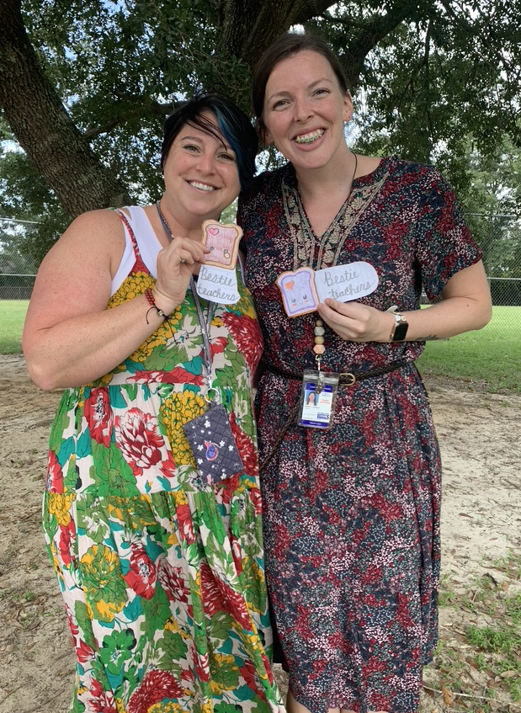
Thank You!!
We look forward to a spectacular, roller coaster of a year with you and your child!

